Slide 2
Course Overview
Day 1: Introduction to ML, Model Building, Text Processing, Bag of Words (BoW), and K Nearest Neighbors Model (KNN)
Day 2: Tree-based Models, Regression Models, Optimization, Regularization, Hyperparameter Tuning, and AWS AI/ML Services
Day 3: Neural Networks, Word Embeddings, Recurrent Neural Networks (RNN), and Transformers
Day 4: Tabular Data, AutoGluon, Image Classification, Convolutional Neural Networks (CNN), and Transfer Learning

Slide 3
Topics for Day 4
Tabular Data
AutoGluon
Computer Vision Applications
Images and Filtering
Convolutional Neural Networks (CNN)
Transfer Learning
Final Project

Slide 4
Topics for Day 4
Tabular Data
AutoGluon
Computer Vision Applications
Images and Filtering
Convolutional Neural Networks (CNN)
Transfer Learning
Final Project

Slide 5
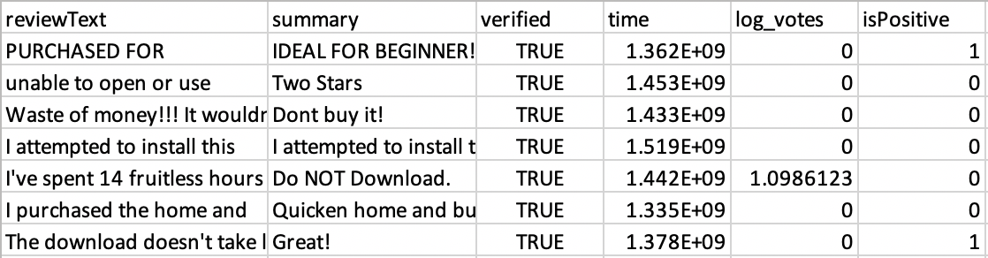
Tabular Data
Tabular data is considered a structured type of data. Data is stored in rows and columns of a table.
With this type of data we usually apply the following pre-processes:
Feature scaling
Imputation
Handling categorical variables

Slide 6
Feature Scaling
Motivation: Many algorithms are sensitive to features being on different scales, e.g., gradient descent and KNN
Solution: Bring features on to the same scale
Note: Some algorithms like decision trees and random forests aren’t sensitive to features on different scales
Common choices (both linear):
Mean/variance standardization
MinMax scaling

Slide 7
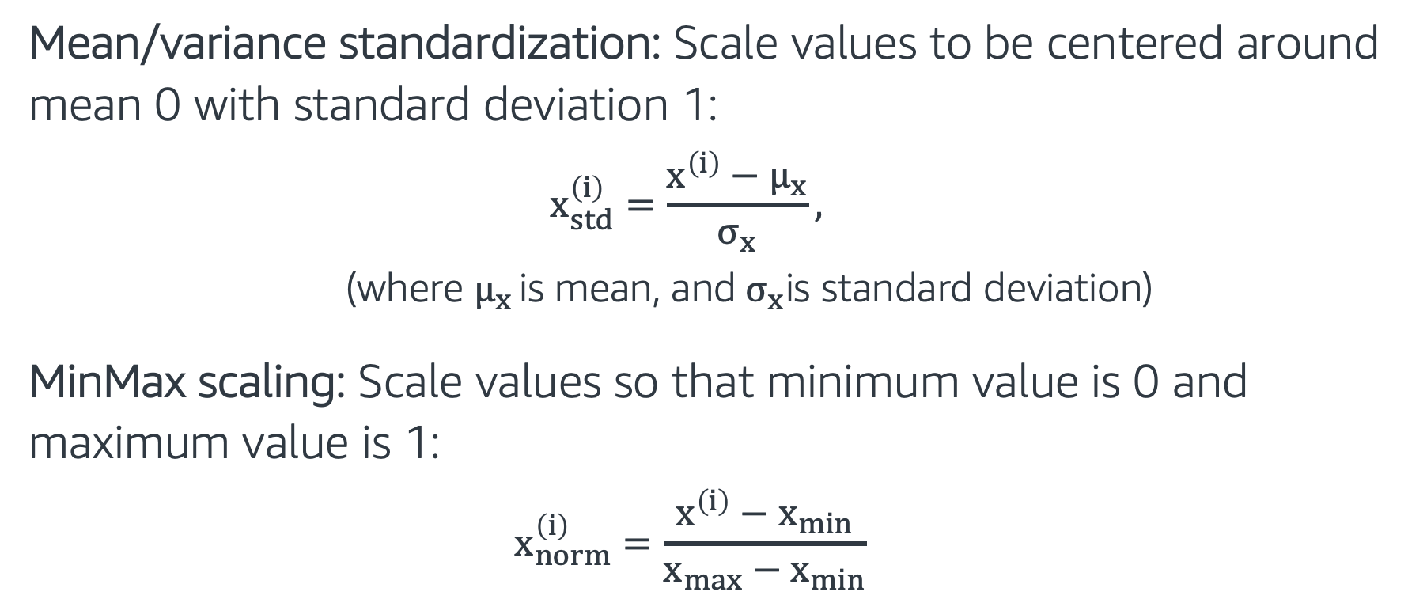
Feature Scaling
Mean/variance standardization: Scale values to be centered around mean 0 with standard deviation 1:
$$x_{std}^{\left(i\right)}=\frac{x^{\left(i\right)}−μ_{x}}{σ_{x}},$$
(where $μ_{x }\text{is} \text{mean}\text{, }\text{and}{ σ}_{x}\text{is} \text{standard} \text{deviation}$)
MinMax scaling: Scale values so that minimum value is 0 and maximum value is 1:
$$x_{norm}^{\left(i\right)}=\frac{x^{\left(i\right)}−x_{min}}{x_{max}−x_{min}}$$

Slide 8
Imputing Missing Values
Average imputation: Replaces missing values with the average value in the column. Useful for numeric variables.
df['col_name'].fillna((df['col_name'].mean()), inplace=True)
Common point imputation: Use the most common value for that column to replace missing values. Useful for categorical variables.
df['col_name'].fillna((df['col_name'].mode()), inplace=True)
Advanced imputation: We can learn to predict missing values from complete samples using some machine learning techniques.
For example: AWS Datawig tool uses neural networks to predict missing values in tabular data. https://github.com/awslabs/datawig

Slide 9
Categorical Variables
Categorical (also called discrete): These variables don’t have a natural numerical representation.
Example: color $∈$ {green, red, blue}, isFraud $∈$ {false, true}
Most Machine Learning models require converting categorical variables to numerical ones.
Label encoding:
Ordinal: Categories are ordered, e.g., size $∈$ {L > M > S}, We can assign L->3, M->2, S->1
Nominal: Categories are unordered, e.g., color, We can assign the numbers randomly

Slide 10
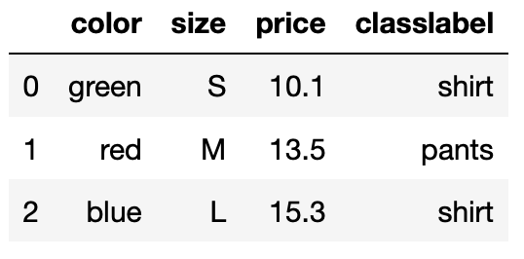
Label Encoding - Example
import pandas as pd
df = pd.DataFrame([
['green', 'S', 10.1, 'shirt'],
['red', 'M', 13.5, 'pants'],
['blue', 'L', 15.3, 'shirt']])
df.columns = ['color', 'size', 'price', 'classlabel']
Let’s encode the color field
from sklearn.preprocessing import LabelEncoder
class_le = LabelEncoder()
y = class_le.fit_transform(df[color'].values)
print(y)
It returns:
[1 2 0]

Slide 11
Label Encoding - Example
import pandas as pd
df = pd.DataFrame([
['green', 'S', 10.1, 'shirt'],
['red', 'M', 13.5, 'pants'],
['blue', 'L', 15.3, 'shirt']])
df.columns = ['color', 'size', 'price', 'classlabel']
Let’s encode the color field
from sklearn.preprocessing import LabelEncoder
class_le = LabelEncoder()
y = class_le.fit_transform(df[color'].values)
print(y)
It returns:
[1 2 0]

Slide 12
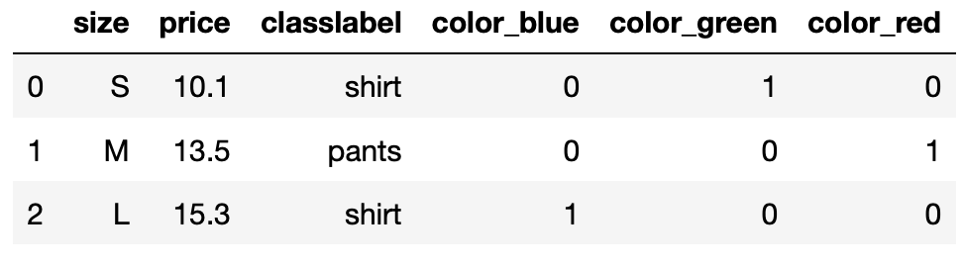
One-Hot Encoding
Problem: Encoding categorical variables with integers is wrong because the ordering and size of the integers is meaningless.
One-hot-encoding: Explode the categorical attributes into many binary attributes
pd.get_dummies(df, columns=['color'])

Slide 13
One-Hot Encoding
Problem: Encoding categorical variables with integers is wrong because the ordering and size of the integers is meaningless.
One-hot-encoding: Explode the categorical attributes into many binary attributes
pd.get_dummies(df, columns=['color'])

Slide 14
Topics for Day 4
Tabular Data
AutoML
Computer Vision Applications
Images and Filtering
Convolutional Neural Networks (CNN)
Transfer Learning
Final Project

Slide 15
AutoML
AutoML helps automating some of the tasks related to ML model development and training such as:
Preprocessing and cleaning data
Feature selection
ML model selection
Hyper-parameter optimization

Slide 16

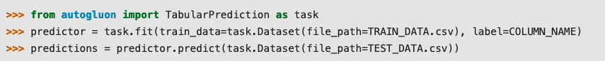
Auto AutoML - Hands on
Open source AutoML Toolkit (AMLT) created by Amazon AI
With AutoGluon, state of the art ML results can be achieved in a few lines of Python code.
Follow through EMBK-NLP-DAY4-AUTOGLUON-NLP-NB.ipynb to see it in action, on our final project dataset (predicting log_votes).

Slide 17
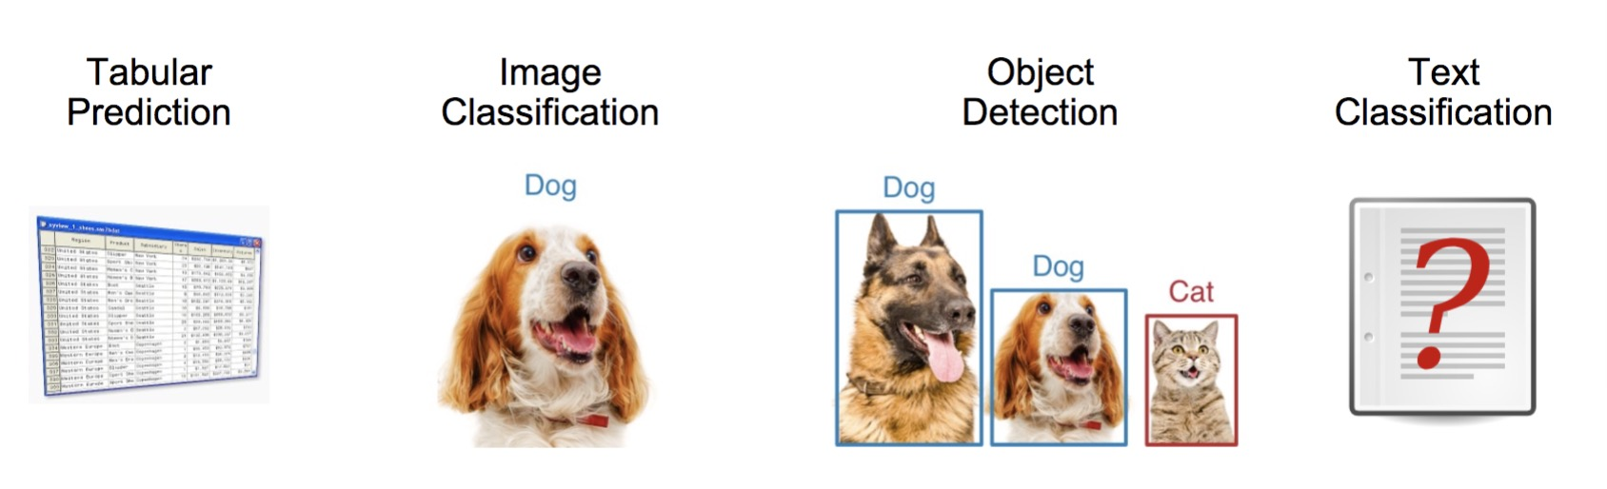
Auto
Easy to Use – Built-in Applications

Slide 18
Topics for Day 4
Tabular Data
AutoML
Computer Vision Applications
Images and Filtering
Convolutional Neural Networks (CNN)
Transfer Learning
Final Project

Slide 19
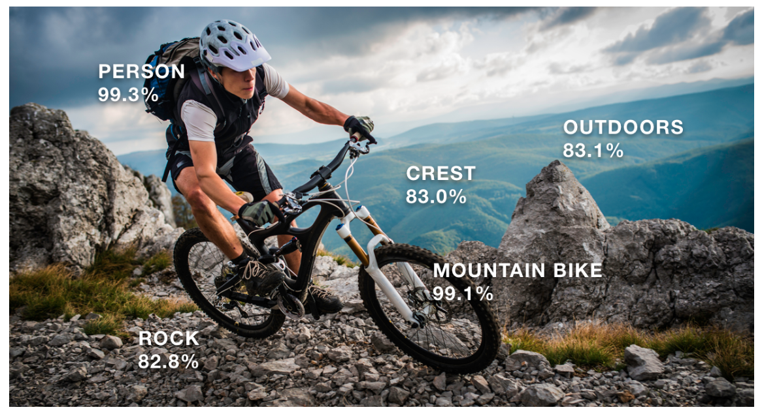
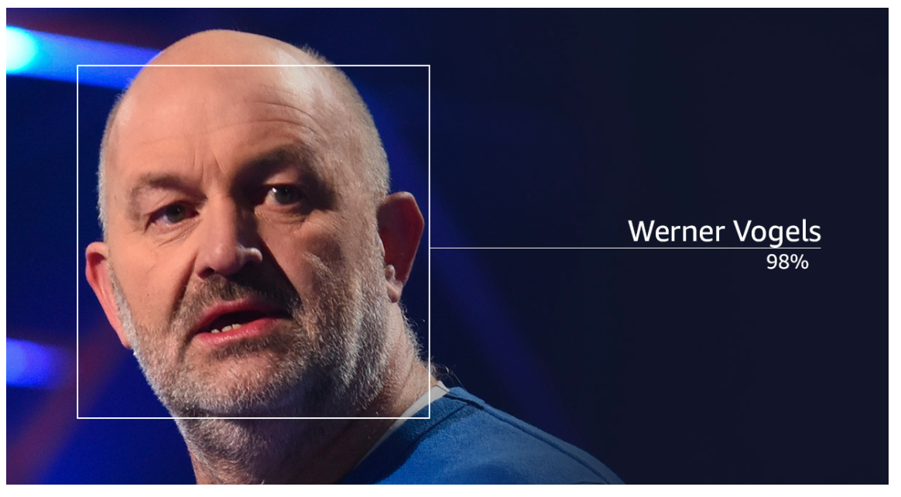
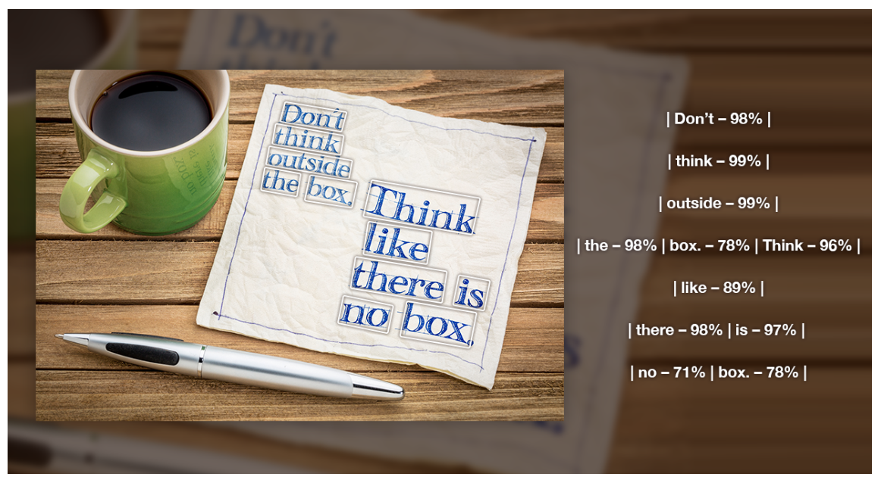
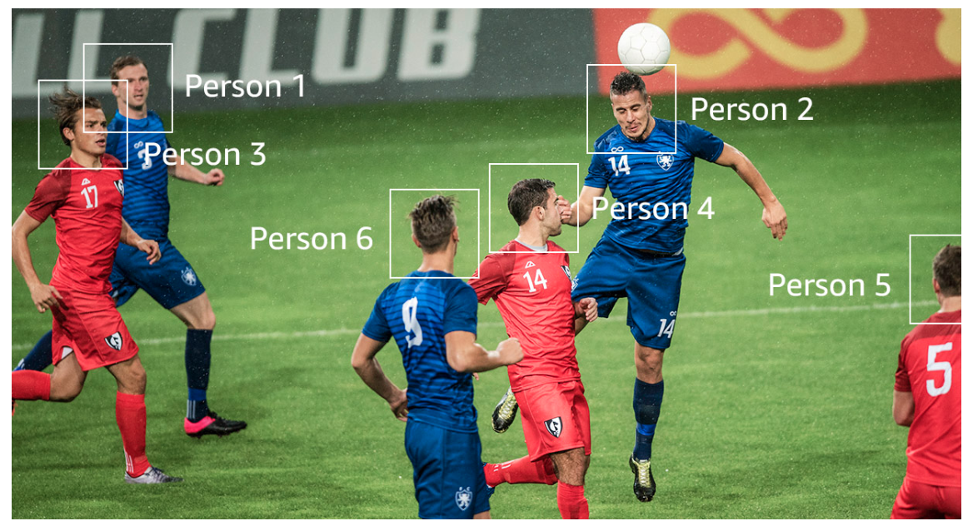
Motivation and Applications
AWS Rekognition: AWS service for different computer vision tasks.
Object detection
Celebrity Recognition
Text in Images
Movement Tracking

Slide 20
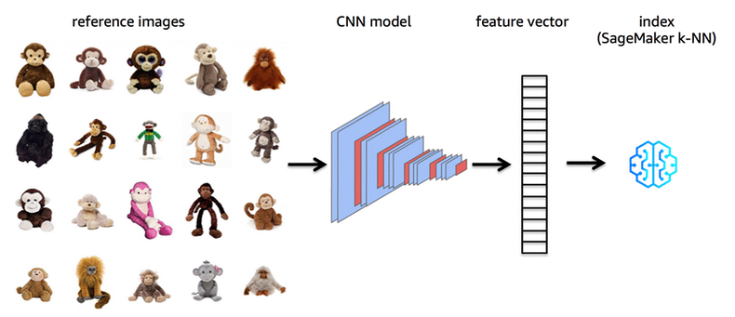
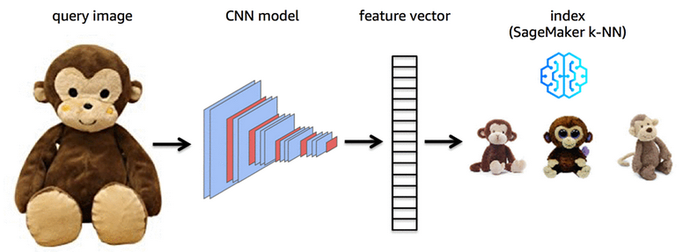
Motivation and Applications
AWS Visual Search: “A picture is worth a thousand words.”
It is a useful search method that takes an image as input and returns similar other images.

Slide 21
Computer Vision (CV) Problems
Although we only focus on image classification, we can mention three main areas.

Slide 22
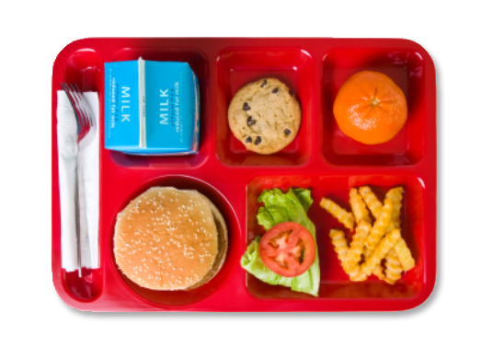
Computer Vision (CV) Problems
Although we only focus on image classification, we can mention three main areas.
Classification: What category (ies) does this image belong to?
Breakfast ?
Lunch ?
Dinner ?

Slide 23
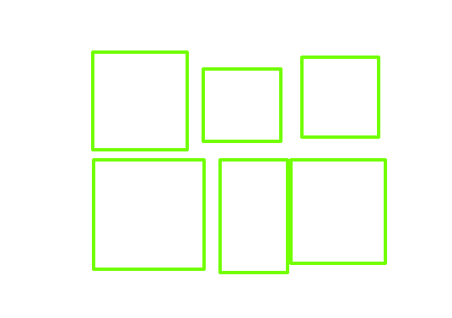
Computer Vision (CV) Problems
Although we only focus on image classification, we can mention three main areas.
Classification: What category (ies) does this image belong to?
Detection: What are the locations of detected objects?
Milk
Hamburger
Cookie
Salad
Orange
French fries

Slide 24
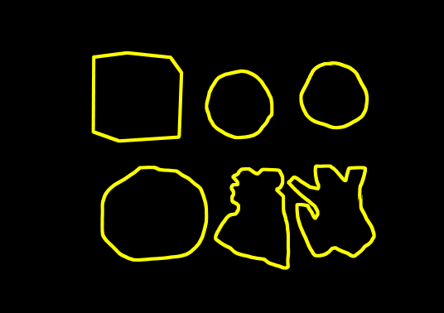
Computer Vision (CV) Problems
Although we only focus on image classification, we can mention three main areas.
Classification: What category (ies) does this image belong to?
Detection: What are the locations of detected objects?
Semantic Segmentation: What are the fine boundaries of detected objects?
Milk
Hamburger
Cookie
Salad
Orange
French fries

Slide 25
Topics for Day 4
Tabular Data
AutoML
Computer Vision Applications
Images and Filtering
Convolutional Neural Networks (CNN)
Transfer Learning
Final Project

Slide 26


Image Representation
Images are made of pixels. Pixels have values between 0-255.
We usually consider color and gray level images.
Color images | Gray level images
There are 3 channels: Red, Green and Blue | Single channel
Pixel intensity: [0, 255] (per channel) | Pixel intensity: [0, 255]

Slide 27
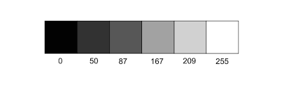
Grayscale Images
Let’s have a 16x16 gray scale image: I
y
I(y=5, x=11) = 198
Pixel Intensities
16 cells
x
16 cells

Slide 28
Color Images
“RED”
“GREEN”
”BLUE”

Slide 29

Color Images
Let’s have a 16x16 color image: I
y
Red
Blue
I(y=5, x=11) = [120, 42, 151]
16 cells
Green
x
16 cells

Slide 30
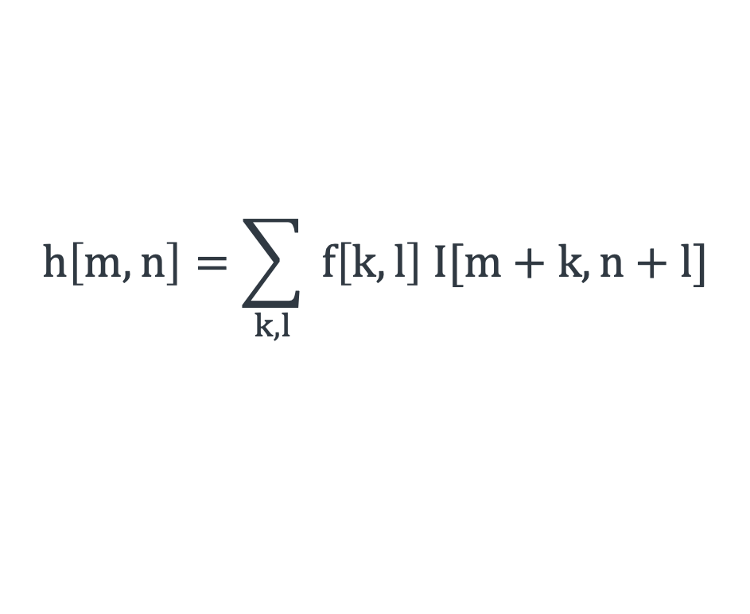
Image Filtering
$$h\left[m, n\right]=\sum_{k,l}{ f\left[k,l\right] I[m+k,n+l]}$$
h: Output, f: Filter, I: image, and k, l are 2D coordinates
10 | 10 | 10 | 15 | 10 | 10 | 10 | 15 | 10 | 10
20 | 20 | 20 | 15 | 15 | 24 | 20 | 10 | 10 | 10
20 | 10 | 10 | 15 | 10 | 10 | 15 | 16 | 10 | 10
20 | 20 | 20 | 15 | 15 | 20 | 20 | 10 | 10 | 10
20 | 10 | 30 | 36 | 30 | 30 | 15 | 15 | 10 | 10
20 | 25 | 32 | 35 | 15 | 30 | 20 | 16 | 20 | 12
30 | 10 | 14 | 15 | 10 | 10 | 15 | 15 | 10 | 15
10 | 10 | 10 | 15 | 15 | 10 | 20 | 25 | 30 | 20
20 | 20 | 15 | 10 | 12 | 10 | 18 | 16 | 10 | 10
20 | 20 | 20 | 16 | 15 | 20 | 24 | 10 | 12 | 10
 | 80
0 | 1 | 0
1 | 1 | 1
0 | 1 | 0
*
=
f: Filter
I: image
h: Output

Slide 31
Image Filtering
$$h\left[m, n\right]=\sum_{k,l}{ f\left[k,l\right] I[m+k,n+l]}$$
h: Output, f: Filter, I: image, and k, l are 2D coordinates
10 | 10 | 10 | 15 | 10 | 10 | 10 | 15 | 10 | 10
20 | 20 | 20 | 15 | 15 | 24 | 20 | 10 | 10 | 10
20 | 10 | 10 | 15 | 10 | 10 | 15 | 16 | 10 | 10
20 | 20 | 20 | 15 | 15 | 20 | 20 | 10 | 10 | 10
20 | 10 | 30 | 36 | 30 | 30 | 15 | 15 | 10 | 10
20 | 25 | 32 | 35 | 15 | 30 | 20 | 16 | 20 | 12
30 | 10 | 14 | 15 | 10 | 10 | 15 | 15 | 10 | 15
10 | 10 | 10 | 15 | 15 | 10 | 20 | 25 | 30 | 20
20 | 20 | 15 | 10 | 12 | 10 | 18 | 16 | 10 | 10
20 | 20 | 20 | 16 | 15 | 20 | 24 | 10 | 12 | 10
 | 80 | 75
0 | 1 | 0
1 | 1 | 1
0 | 1 | 0
*
=
f: Filter
I: image
h: Output

Slide 32
Image Filtering
$$h\left[m, n\right]=\sum_{k,l}{ f\left[k,l\right] I[m+k,n+l]}$$
h: Output, f: Filter, I: image, and k, l are 2D coordinates
10 | 10 | 10 | 15 | 10 | 10 | 10 | 15 | 10 | 10
20 | 20 | 20 | 15 | 15 | 24 | 20 | 10 | 10 | 10
20 | 10 | 10 | 15 | 10 | 10 | 15 | 16 | 10 | 10
20 | 20 | 20 | 15 | 15 | 20 | 20 | 10 | 10 | 10
20 | 10 | 30 | 36 | 30 | 30 | 15 | 15 | 10 | 10
20 | 25 | 32 | 35 | 15 | 30 | 20 | 16 | 20 | 12
30 | 10 | 14 | 15 | 10 | 10 | 15 | 15 | 10 | 15
10 | 10 | 10 | 15 | 15 | 10 | 20 | 25 | 30 | 20
20 | 20 | 15 | 10 | 12 | 10 | 18 | 16 | 10 | 10
20 | 20 | 20 | 16 | 15 | 20 | 24 | 10 | 12 | 10
 | 80 | 75 | 80
0 | 1 | 0
1 | 1 | 1
0 | 1 | 0
*
=
f: Filter
I: image
h: Output

Slide 33
Image Filtering
$$h\left[m, n\right]=\sum_{k,l}{ f\left[k,l\right] I[m+k,n+l]}$$
h: Output, f: Filter, I: image, and k, l are 2D coordinates
10 | 10 | 10 | 15 | 10 | 10 | 10 | 15 | 10 | 10
20 | 20 | 20 | 15 | 15 | 24 | 20 | 10 | 10 | 10
20 | 10 | 10 | 15 | 10 | 10 | 15 | 16 | 10 | 10
20 | 20 | 20 | 15 | 15 | 20 | 20 | 10 | 10 | 10
20 | 10 | 30 | 36 | 30 | 30 | 15 | 15 | 10 | 10
20 | 25 | 32 | 35 | 15 | 30 | 20 | 16 | 20 | 12
30 | 10 | 14 | 15 | 10 | 10 | 15 | 15 | 10 | 15
10 | 10 | 10 | 15 | 15 | 10 | 20 | 25 | 30 | 20
20 | 20 | 15 | 10 | 12 | 10 | 18 | 16 | 10 | 10
20 | 20 | 20 | 16 | 15 | 20 | 24 | 10 | 12 | 10
 | 80 | 75 | 80 | 74 | 79 | 79 | 71 | 50
 | 80 | 75 | 65 | 65 | 79 | 81 | 61 | 56
 | 80 | 95 | 101 | 90 | 95 | 80 | 71 | 50
 | 105 | 128 | 146
0 | 1 | 0
1 | 1 | 1
0 | 1 | 0
*
=
f: Filter
I: image
h: Output

Slide 34
Image Filtering
$$h\left[m, n\right]=\sum_{k,l}{ f\left[k,l\right] I[m+k,n+l]}$$
h: Output, f: Filter, I: image, and k, l are 2D coordinates
10 | 10 | 10 | 15 | 10 | 10 | 10 | 15 | 10 | 10
20 | 20 | 20 | 15 | 15 | 24 | 20 | 10 | 10 | 10
20 | 10 | 10 | 15 | 10 | 10 | 15 | 16 | 10 | 10
20 | 20 | 20 | 15 | 15 | 20 | 20 | 10 | 10 | 10
20 | 10 | 30 | 36 | 30 | 30 | 15 | 15 | 10 | 10
20 | 25 | 32 | 35 | 15 | 30 | 20 | 16 | 20 | 12
30 | 10 | 14 | 15 | 10 | 10 | 15 | 15 | 10 | 15
10 | 10 | 10 | 15 | 15 | 10 | 20 | 25 | 30 | 20
20 | 20 | 15 | 10 | 12 | 10 | 18 | 16 | 10 | 10
20 | 20 | 20 | 16 | 15 | 20 | 24 | 10 | 12 | 10
 | 80 | 75 | 80 | 74 | 79 | 79 | 71 | 50
 | 80 | 75 | 65 | 65 | 79 | 81 | 61 | 56
 | 80 | 95 | 101 | 90 | 95 | 80 | 71 | 50
 | 105 | 128 | 146 | 126 | 125 | 100 | 66 | 65
 | 97 | 136 | 133 | 120 | 105 | 96 | 86 | 68
 | 89 | 81 | 89 | 65 | 75 | 80 | 81 | 90
 | 60 | 64 | 65 | 62 | 65 | 88 | 106 | 95
 | 85 | 75 | 68 | 62 | 70 | 88 | 79 | 78
0 | 1 | 0
1 | 1 | 1
0 | 1 | 0
*
=
f: Filter
I: image
h: Output

Slide 35
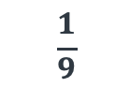
Smoothing Filters
Smoothing filters blur the strong lines and structures in the images. It also removes the noise and details in the image.
Sample filter:
Mean filter: Replaces each pixel with the average value in its neighborhood.
1 | 1 | 1
1 | 1 | 1
1 | 1 | 1
For example:
$$\frac{1}{9}$$

Slide 36
Edge Detection Filter
Edge Detection: Helpful in image classification and object detection problems. Filters emphasize abrupt intensity changes (edges).
Sample filters:
Prewitt filter:
-1 | 0 | 1
-1 | 0 | 1
-1 | 0 | 1
1 | 1 | 1
0 | 0 | 0
-1 | -1 | -1
M_{x} =
M_{y} =

Slide 37
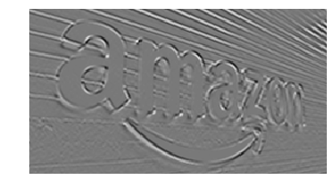
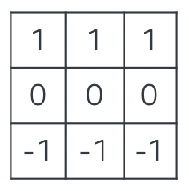
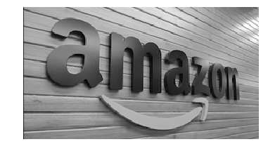
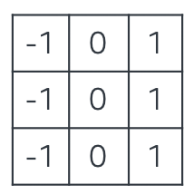
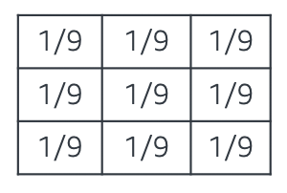
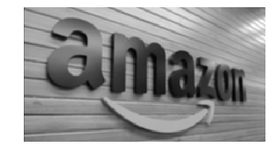
Image Filtering
Edge Detection
Original Image
Blur

Slide 38
Image Filtering - Hands on
In this exercise, we explore some simple image filters
Edge detection filters
Simple vertical and/or horizontal filters
Prewitt filters
Smoothing filters
Gaussian filters
Follow through this notebook: “EMBK-NLP-DAY4-FILTERS-NB.ipynb”

Slide 39
Topics for Day 4
Tabular Data
AutoML
Computer Vision Applications
Images and Filtering
Convolutional Neural Networks (CNN)
Transfer Learning
Final Project

Slide 40
Convolutional Neural Networks
Remember a filter has a set of specific values that does a specific task such as blurring an image, edge detection.
Main idea: Instead of trying different features (color, corner, edge detection etc.), why don’t we let the algorithm find the best features by using filters.
Apply multiple kernels with random weights (values).
We will learn the weights through training.

Slide 41
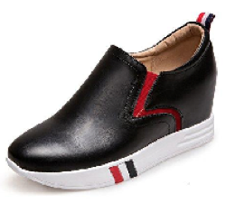
Convolutional Neural Networks
A simple Convolutional Network is usually made of these layers:
Convolution: Works as feature extractor. We slide 2D filters and apply filtering. The resulting images are called feature maps.
Pooling: Reduces the size of feature maps (horizontally and vertically)
Fully connected (Dense): Regular Neural Networks as intro in MLP
Convolution
Convolution
Fully connected
Convolution
Ring ?
Jeans ?
Watch ?
Shoe ?
Shirt ?
Pooling
Flattening
Pooling
Classification
Pooling

Slide 42
Filters and Convolution
Starting with random filter values (weights). We will find the optimum values through training. We can have as many as filters as we need.
Main purpose is learning the important features, also called feature extraction.
…
…
: Filter (kernel)
…
RGB
Filter # 2
Filter # 1
Convolution 1
Convolution 2

Slide 43
Pooling (Down sampling)
After applying filters, we apply pooling to reduce the size of feature maps.
…
…
m
m
m/2
n/2
RGB
n
n
Convolution
Pooling

Slide 44
Pooling (Down sampling)
Two main types:
Max Pooling: Pick the max value
Average Pooling: Take the average value
Example: Max Pooling
Size: 6x6
Size: 3x3
32 | 45 | 55 | 123 | 44 | 95
13 | 65 | 54 | 23 | 98 | 43
12 | 32 | 54 | 33 | 42 | 12
78 | 45 | 76 | 21 | 25 | 76
47 | 41 | 43 | 87 | 65 | 77
32 | 23 | 48 | 76 | 91 | 89
65 | 123 | 98
78 | 76 | 76
47 | 87 | 91

Slide 45
Convolution and Pooling
We can stack as many convolution-pooling layers.
1
2
3
Convolution
Convolution
Convolution
Fully connected
Ring ?
Jeans ?
Watch ?
Shoe ?
Flattening
Shirt ?
Pooling
Pooling
Pooling
Classification

Slide 46
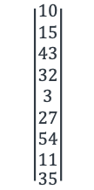
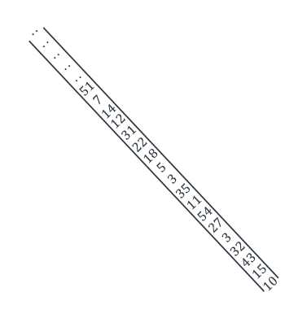
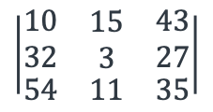
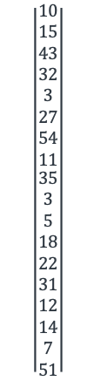
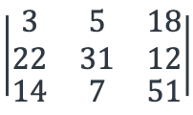
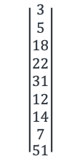
Flattening
$$\left|\begin{matrix}\begin{aligned}10 \\ 15 \\ 43 \\ 32 \\ 3 \\ 27 \\ 54 \\ 11\end{aligned} \\ 35\end{matrix}\right|$$
$$\left|\begin{matrix}\begin{aligned}10 \\ 15 \\ 43 \\ 32 \\ 3 \\ 27 \\ 54 \\ 11\end{aligned} \\ \begin{aligned}35 \\ 3 \\ 5 \\ 18 \\ 22 \\ 31 \\ 12 \\ 14 \\ 7 \\ 51\end{aligned}\end{matrix}\right|$$
$$\left|\begin{matrix}\begin{aligned}.. \\ .. \\ .. \\ .. \\ .. \\ 51 \\ 7 \\ 14\end{aligned} \\ \begin{aligned}12 \\ 31 \\ 22 \\ 18 \\ 5 \\ 3 \\ 35 \\ 11 \\ 54 \\ 27 \\ 3 \\ 32 \\ 43 \\ 15 \\ 10\end{aligned}\end{matrix}\right|$$
$$\left|\begin{matrix}\begin{aligned}10 \\ 32\end{aligned} & \begin{aligned}15 \\ 3\end{aligned} & \begin{aligned}43 \\ 27\end{aligned} \\ 54 & 11 & 35\end{matrix}\right|$$
Channel 1
Convolution
=
$$\left|\begin{matrix}\begin{aligned}3 \\ 22\end{aligned} & \begin{aligned}5 \\ 31\end{aligned} & \begin{aligned}18 \\ 12\end{aligned} \\ 14 & 7 & 51\end{matrix}\right|$$
$$\left|\begin{matrix}\begin{aligned}3 \\ 5 \\ 18 \\ 22 \\ 31 \\ 12 \\ 14 \\ 7\end{aligned} \\ 51\end{matrix}\right|$$
Flatten
Channel 2
Pooling
..
..
..
..
..
..
..
..
..
..
..
..
Channel q
Pooling or Convolution result
Flatten

Slide 47
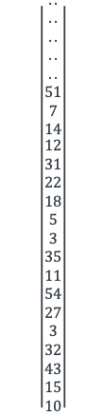
Fully Connected (FC) Layer
Layer(s) with regular neurons.
These neurons are fully connected to the previous layer.
$$\left|\begin{matrix}\begin{aligned}.. \\ .. \\ .. \\ .. \\ .. \\ 51 \\ 7 \\ 14\end{aligned} \\ \begin{aligned}12 \\ 31 \\ 22 \\ 18 \\ 5 \\ 3 \\ 35 \\ 11 \\ 54 \\ 27 \\ 3 \\ 32 \\ 43 \\ 15 \\ 10\end{aligned}\end{matrix}\right|$$
Convolution
Flatten
.
.
.
.
.
We can extend this layer by adding more FC layers
Pooling
Fully
Connected 1
Fully
Connected 2

Slide 48
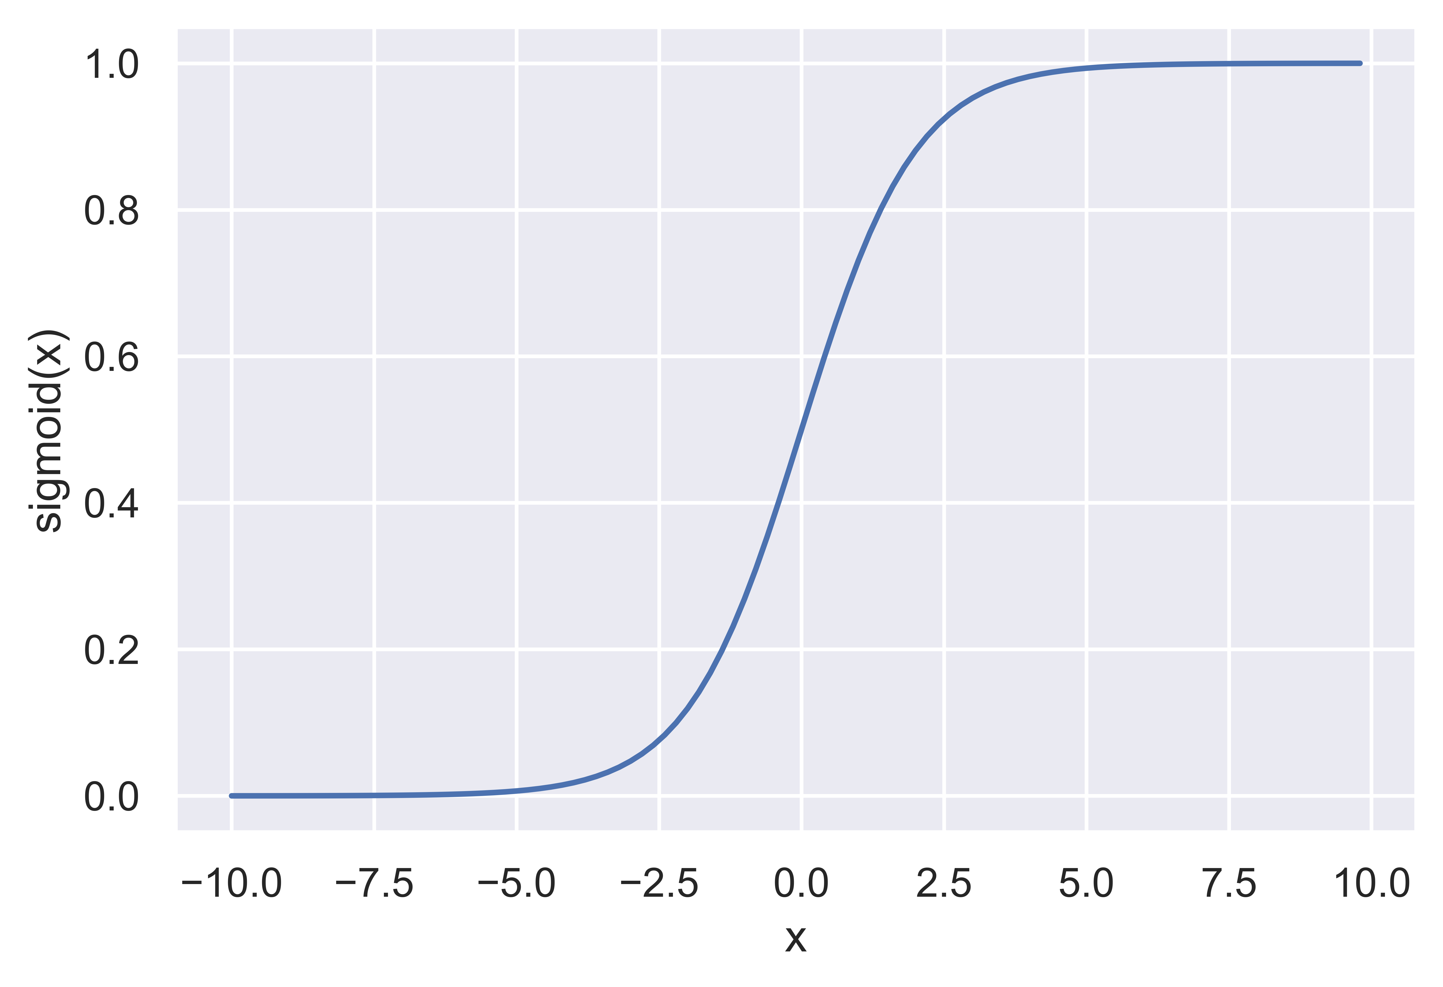
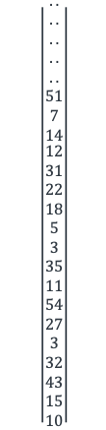
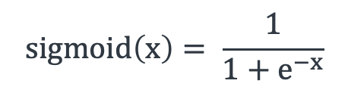
Classification
Binary classification: We will use sigmoid activated single neuron.
$$sigmoid\left(x\right)= \frac{1}{1+e^{−x}}$$
$$\left|\begin{matrix}\begin{aligned}.. \\ .. \\ .. \\ .. \\ .. \\ 51 \\ 7 \\ 14\end{aligned} \\ \begin{aligned}12 \\ 31 \\ 22 \\ 18 \\ 5 \\ 3 \\ 35 \\ 11 \\ 54 \\ 27 \\ 3 \\ 32 \\ 43 \\ 15 \\ 10\end{aligned}\end{matrix}\right|$$
.
.
.
.
.
Shoe
Not Shoe
Classification
Fully
Connected 1
Fully
Connected 2

Slide 49
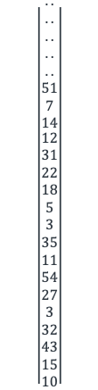
Classification
Multi-class classification: We will use softmax function. We have these classes: Ring, jeans, watch, shoe, shirt
Softmax assigns probabilities to each class that add up to 1
For example:
$$\left|\begin{matrix}\begin{aligned}.. \\ .. \\ .. \\ .. \\ .. \\ 51 \\ 7 \\ 14\end{aligned} \\ \begin{aligned}12 \\ 31 \\ 22 \\ 18 \\ 5 \\ 3 \\ 35 \\ 11 \\ 54 \\ 27 \\ 3 \\ 32 \\ 43 \\ 15 \\ 10\end{aligned}\end{matrix}\right|$$
.
.
.
.
.
Ring ?
Jeans ?
Class | Probability
Ring | 0.18
Jeans | 0.04
Watch | 0.10
Shoe | 0.62
Shirt | 0.06
Watch ?
Shoe ?
Shirt ?
Softmax
Fully
Connected 1
Fully
Connected 2
Classification
1.0

Slide 50
Some important CNN Models
In this section we will look at some important CNN models:
LeNet (1998): the first CNN, ~60k parameters
AlexNet (2012)
More deeper, ~60M parameters
ReLU, Dropout, MaxPooling
VGG-16 (2014)
Narrower and deeper, ~138M parameters
Repeated VGG blocks
ResNet (2015)
Residual blocks

Slide 51
LeNet
The first CNN attempt to classify digits on MNIST dataset
LeNet is a five layer convolutional neural network
More details

Slide 52
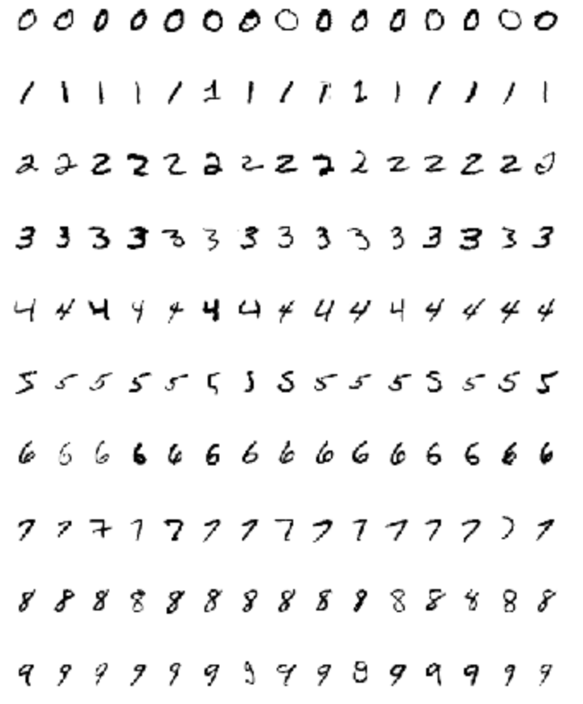
LeNet
MNIST: Handwritten grayscale digit
(between 0-9) images
50,000 training data
10,000 test data
10 classes
Grayscale
28 x 28 pixels per image
Centered and scaled

Slide 53
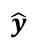
LeNet
5x5
s=1
f=2
s=2
5x5
s=1
f=2
s=2
FC
FC
..
..
..
..
$$\hat{y}$$
32x32x1
28x28x6
14x14x6
10x10x16
5x5x16
120
84
Convolution
Average
Pooling
Convolution
Average
Pooling
Fully
Connected
Fully
Connected
~60,000 parameters
Sigmoid and tanh activations are used

Slide 54
AlexNet
Won the ImageNet 2012 competition
More complicated architecture than LeNet
~60 M parameters
Key modifications:
Dropout (regularization)
Replaced tanh and sigmoid activations with ReLU
MaxPooling rather than AvgPooling
More details
LeNet
AlexNet

Slide 55
AlexNet
11x11
s=4
f=3x3
s=2
5x5
same
f=3x3
s=2
Conv 96
Max.
Pooling
Conv
256
Max.
Pooling
227x227x3
55x55x96
27x27x96
27x27x256
13x13x256
3x3
same
3x3
same
3x3
same
f=3x3
s=2
..
..
Conv
384
Conv
384
Conv
256
Max.
Pooling
FC
..
..
FC
..
..
FC
..
..
..
..
13x13x384
13x13x384
13x13x256
6x6x256
9216
4096
4096
Softmax
1000
9216

Slide 56
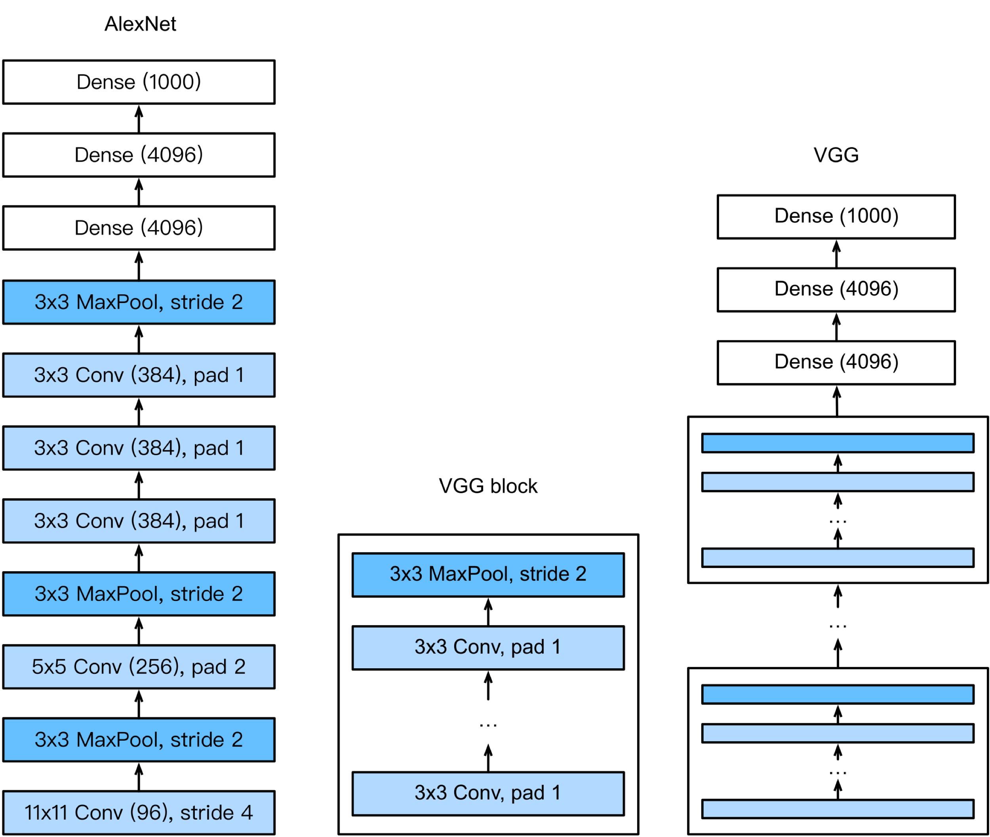
VGGNet
“Very Deep Convolutional Networks For Large-scale Image Recognition”
VGGNet simplified the CNN architectures: Same convolutions with max-pooling.
More details

Slide 57
VGG-16
3x3
same
f=2x2
s=2
3x3
same
f=2x2
s=2
Conv 64
X 2
Max.
Pooling
Conv 128
X 2
Max.
Pooling
224x224x3
224x224x64
112x112x64
112x112x128
56x56x128
Deeper than AlexNet
16 layers
~138 mil parameters
3x3
same
f=2x2
s=2
3x3
same
f=2x2
s=2
Conv 256
X 3
Max.
Pooling
Conv 512
X 3
Max.
Pooling
56x56x256
28x28x256
28x28x512
14x14x512
3x3
same
f=2x2
s=2
..
..
Conv 512
X 3
Max.
Pooling
..
..
..
..
FC
FC
14x14x512
7x7x512
4096
4096
Softmax
1000

Slide 58
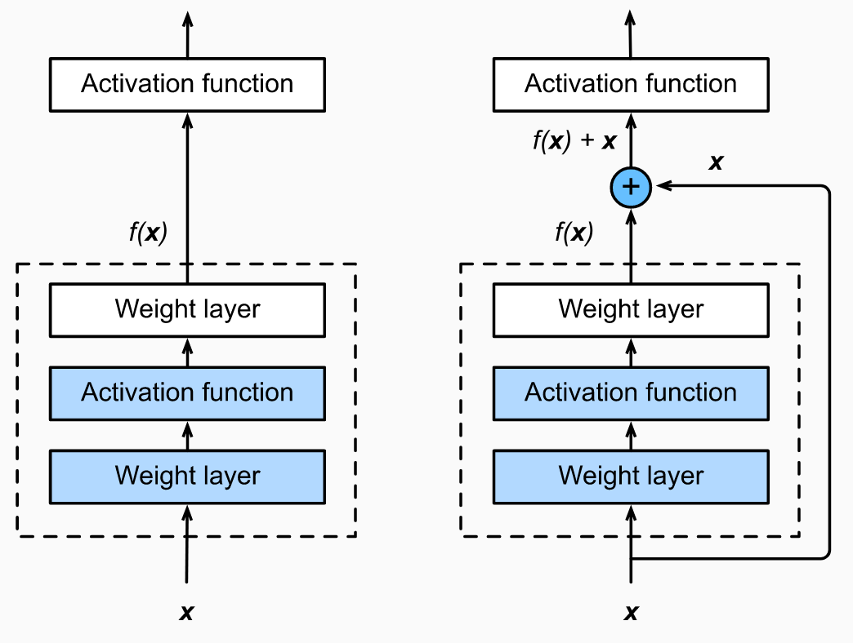
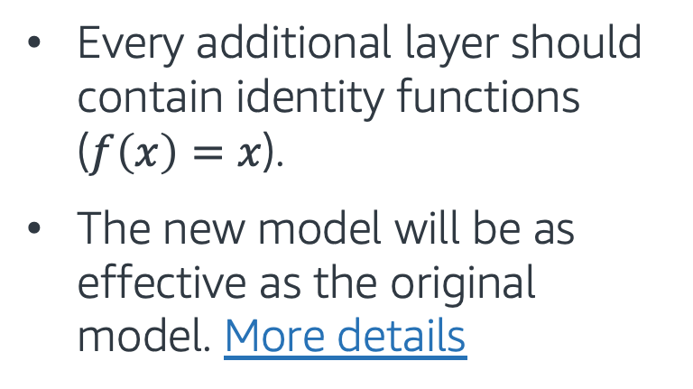
Residual Network (ResNet)
We want to make sure: Adding more layers makes the network “more expressive rather than just being different”.
Regular
With residual
Every additional layer should contain identity functions ($f\left(x\right)=x$).
The new model will be as effective as the original model. More details

Slide 59
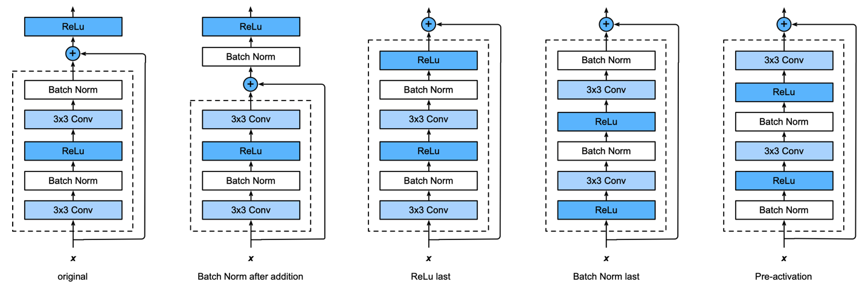
The many flavors of ResNet blocks
Try every permutation:

Slide 60
Topics for Day 4
Tabular Data
AutoML
Computer Vision Applications
Images and Filtering
Convolutional Neural Networks (CNN)
Transfer Learning
Final Project

Slide 61
Pre-trained Models
These models tend to be very large, and can take a long time to train on the most expensive instances. Thus, is common to pre-train a model on large image datasets, and use it for downstream tasks.
The Gluon CV Model Zoo contains a large number of pretrained CNNs. You can find AlexNet, VGGNet and more models there.

Slide 62
Utilizing Pre-trained Models
There are multiple ways to use these pre-trained models:
Use it as a fixed classifier (no training cost). We investigate this in a notebook example.
The model can be fine-tuned end-to-end as a classifier.
The model can be trained from scratch. This is very intensive, and should only be done with large datasets.
INCREASING COST

Slide 63
Transfer Learning - Hands on # 1
In this exercise, we work with a pre-trained model for image classification
The exercise covers the following topics we learned today:
Pre-trained CNNs from Gluon CV Model_Zoo
Transfer Learning, as a fixed classifier
Follow through this notebook: “EMBK-NLP-DAY4-GLUON-CV-NB.ipynb”

Slide 64
Transfer Learning - Hands on # 2
Transfer Learning: Instead of training a CNN from scratch, we can use a pre-trained network and make adjustments.
Transfer Learning (Fine Tuning) may involve:
Adjusting the output layer to the desired number of classes
Freezing pre-trained model’s weights at certain layers (shorter training time)
Follow through this notebook: “EMBK-NLP-DAY4-GLUON-CV-TRAIN-NB.ipynb”

Slide 65
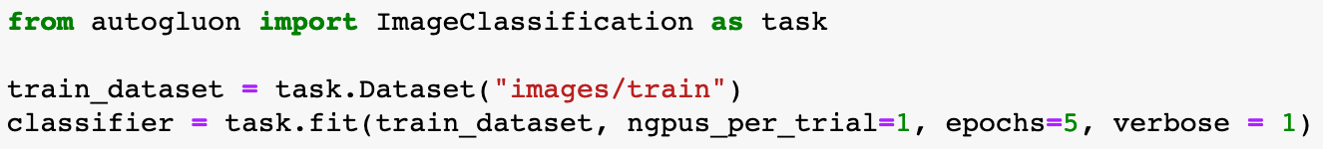
Auto C CV - Hands on
With AutoGluon CV, state of the art ML results can be achieved in a few lines of Python code.
Follow through EMBK-NLP-DAY4-AUTOGLUON-CV-NB.ipynb to see how it works.

Slide 66
Topics for Day 4
Tabular Data
AutoML
Computer Vision Applications
Images and Filtering
Convolutional Neural Networks (CNN)
Transfer Learning
Final Project

Slide 67
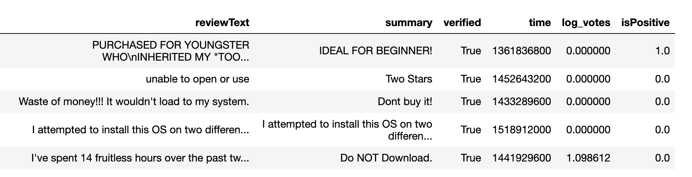
Final Project – Sentiment Analysis
Data: Customer reviews. Let's look at first 5 rows of the training dataset:
Task: Train a classifier to predict the isPositive field for the test dataset.
Follow through this notebook ”EMBK-NLP-DAY4-FINAL-STUDENT-NB.ipynb” to start on the final project.

Slide 68
Notebooks for Day 4
EMBK-NLP-DAY4-AUTOGLUON-NLP-NB.ipynb: AutoGluon TAB/NLP
EMBK-NLP-DAY4-FILTERS-NB.ipynb: Convolutions and Filters
EMBK-NLP-DAY4-GLUON-CV-NB.ipynb: Using a Pre-trained Model from Gluon CV Model-Zoo as a fixed classifier
EMBK-NLP-DAY4-GLUON-CV-TRAIN-NB.ipynb: Fine-tune a pre-trained model
EMBK-NLP-DAY4-AUTOGLUON-CV-NB.ipynb: Apply AutoGluon on images
EMBK-NLP-DAY4-FINAL-STUDENT-NB.ipynb: Final Project Walkthrough for Day 4
EMBK-NLP-DAY4-FINAL-SOLUTION-NB.ipynb: Final Project Solution for Day 4

